Slide 1



PRESENTS
Notes:
V2.0

Slide 2
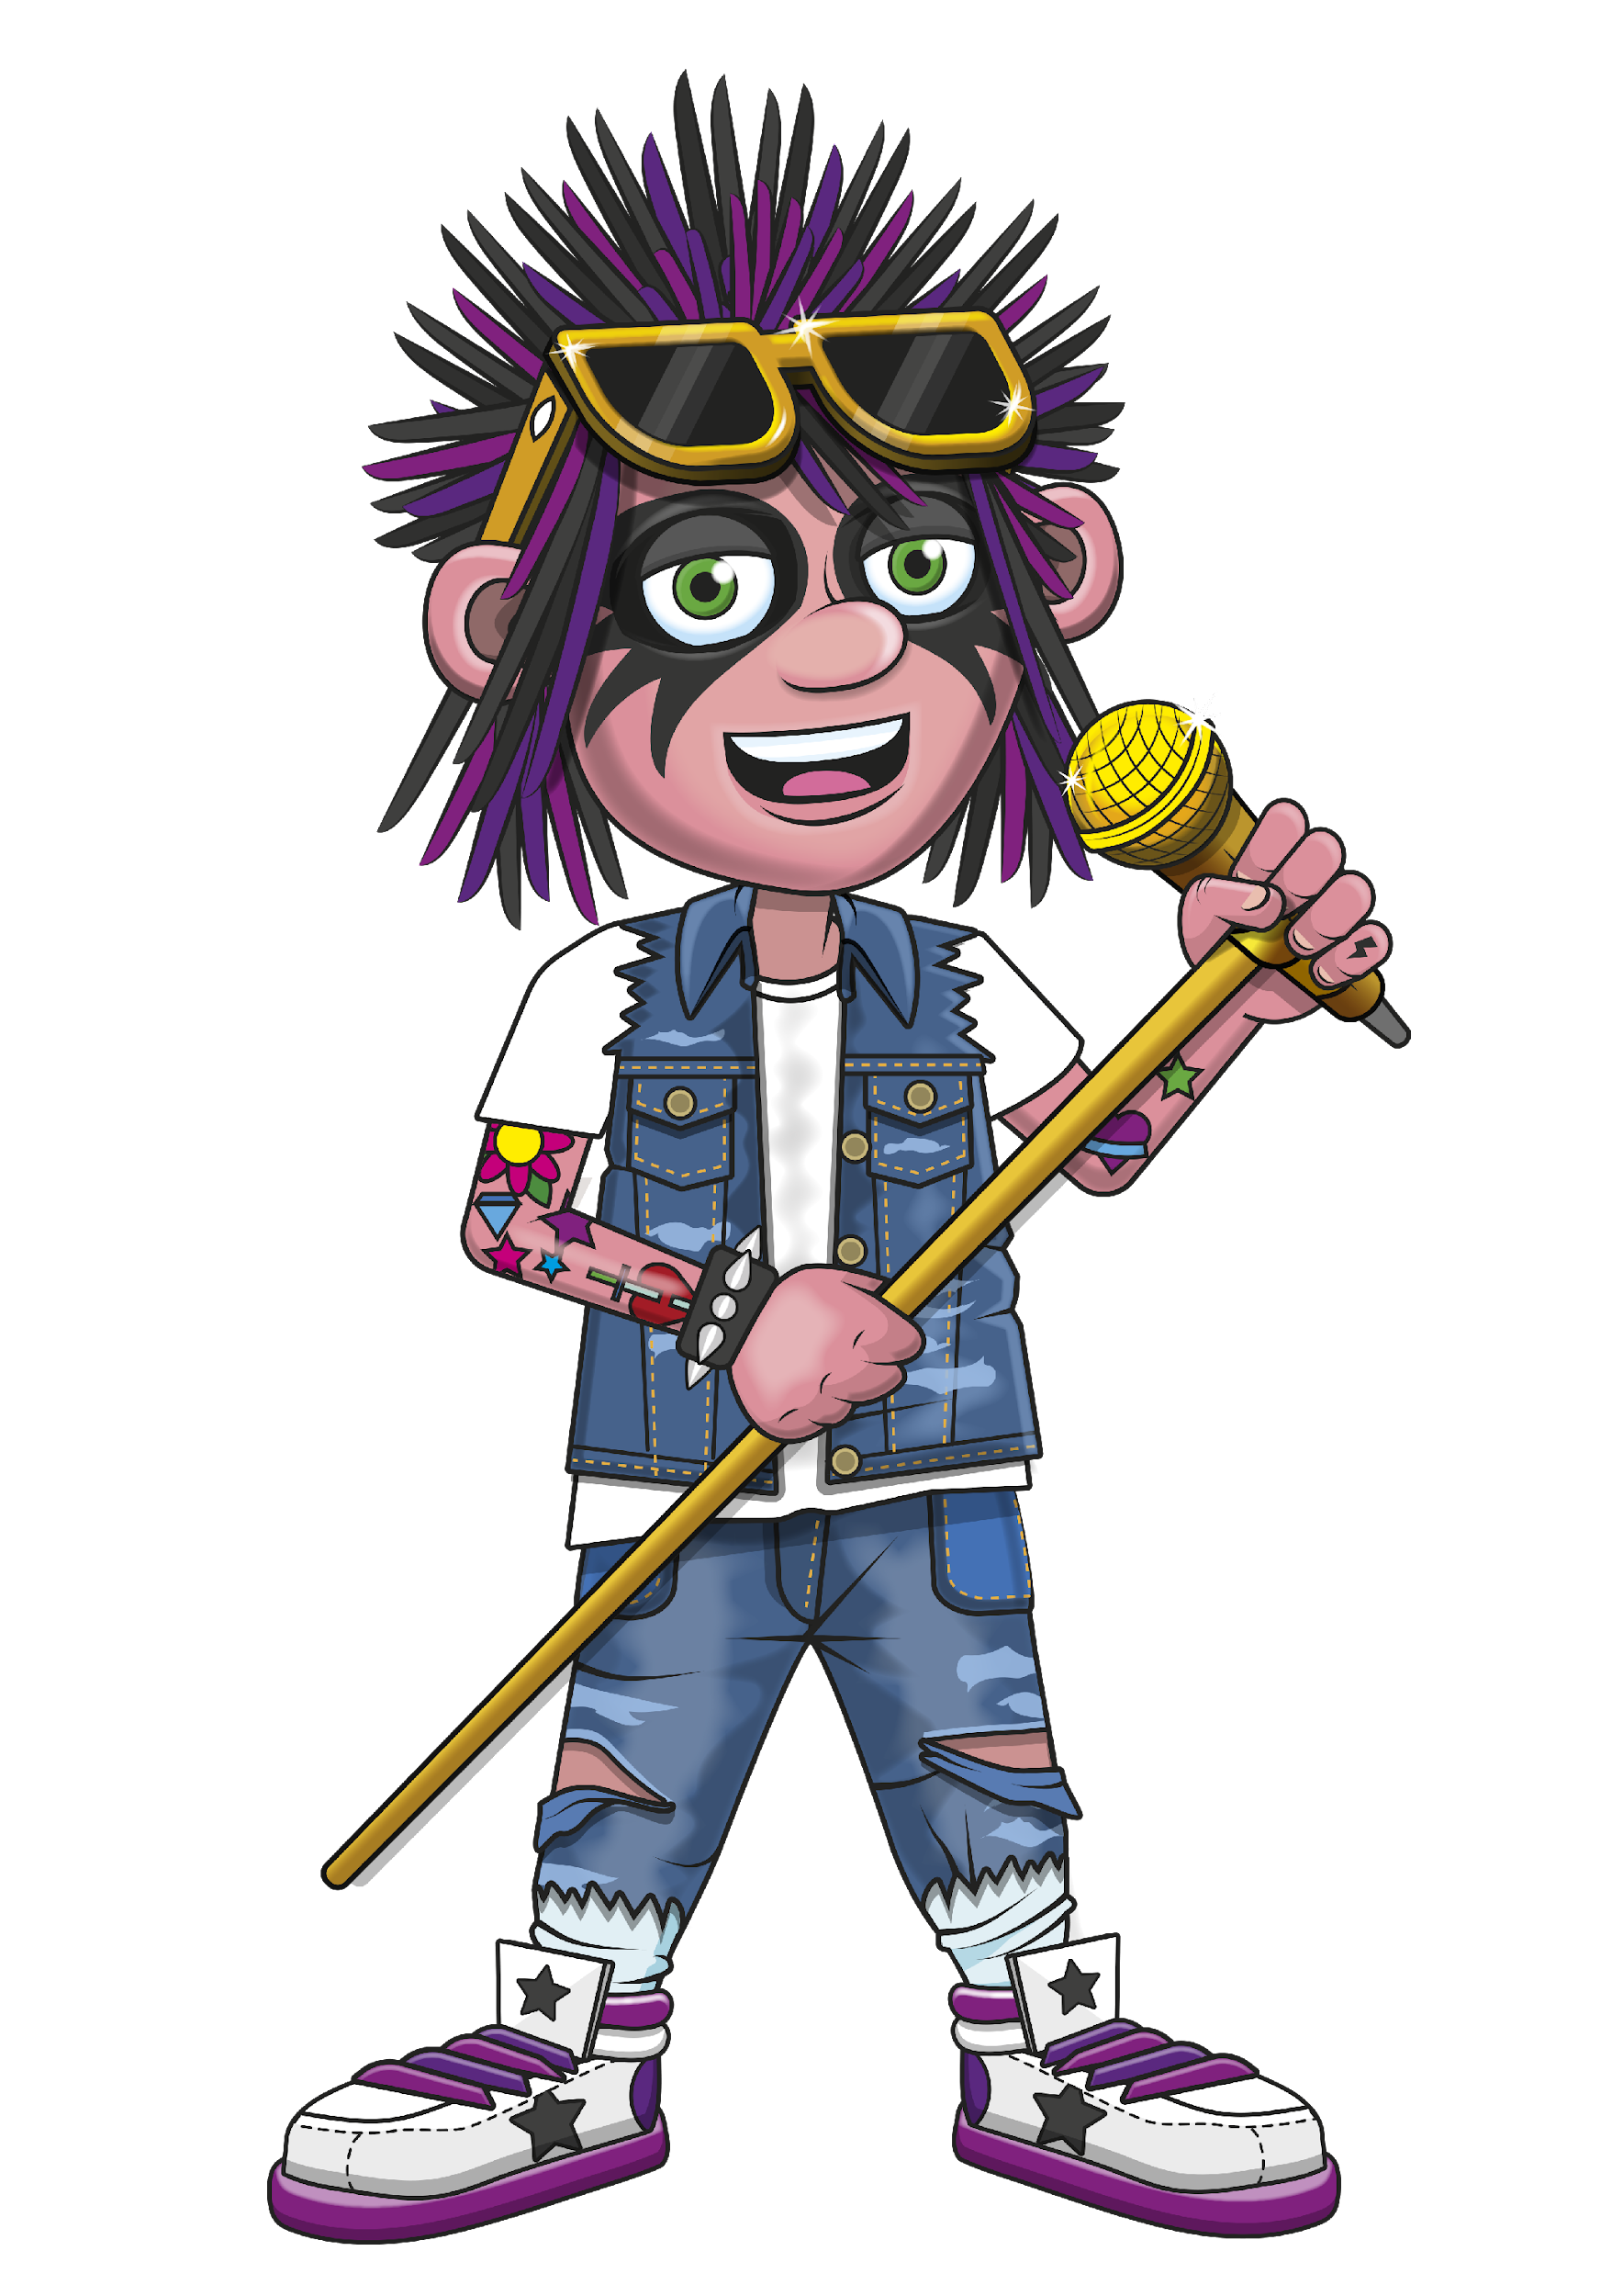

A GUIDE TO THE MTC
GUIDE

Slide 3

TODAY
What is the MTC?
MTC key facts
Preparing pupils
Q & A

Slide 4
WHAT IS THE MTC?
MTC stands for ‘Multiplication Tables Check’.
Online quiz for year 4 children in England, set by the government.
Pupils demonstrate their times tables skills, which they’ve been practising for years.
Helps us to know your children are ready for year 5 maths

Slide 5
MTC KEY FACTS
Must be taken in school between 1st and 12th June 2026
Start with 3 practice questions
Then 25 multiplication questions (no division)
For each question, you must enter an answer within 6s
3s pause between questions

Slide 6
MTC RESULTS
Full marks is 25/25 but there’s no pass mark
We will share your child’s results with their report at the end of the year
Each school finds out the Local Authority and National average but not each other’s results.
More guidance can be found here
Notes:
Explain how the school plans to share the results with parents and carers
Reassure parents and carers that their child’s results are only known to the school. There isn’t a public results table.
Other schools won’t even find out our average score.

Slide 7
PREPARING PUPILS : SCHOOL
We might…
spend a little more time learning times tables in class
set times tables homework
organise class tournaments
Notes:
Please edit this page as you wish!

Slide 8
PREPARING PUPILS : OUT OF SCHOOL
Regular, short verbal times tables practice
Kitchen, bathroom, bedroom, walking
Play TTRS on mobile/tablet/computer
Those who scored 25 last year typically played 6 minutes three times a week.
Notes:
Please edit this page as you wish!

Slide 9
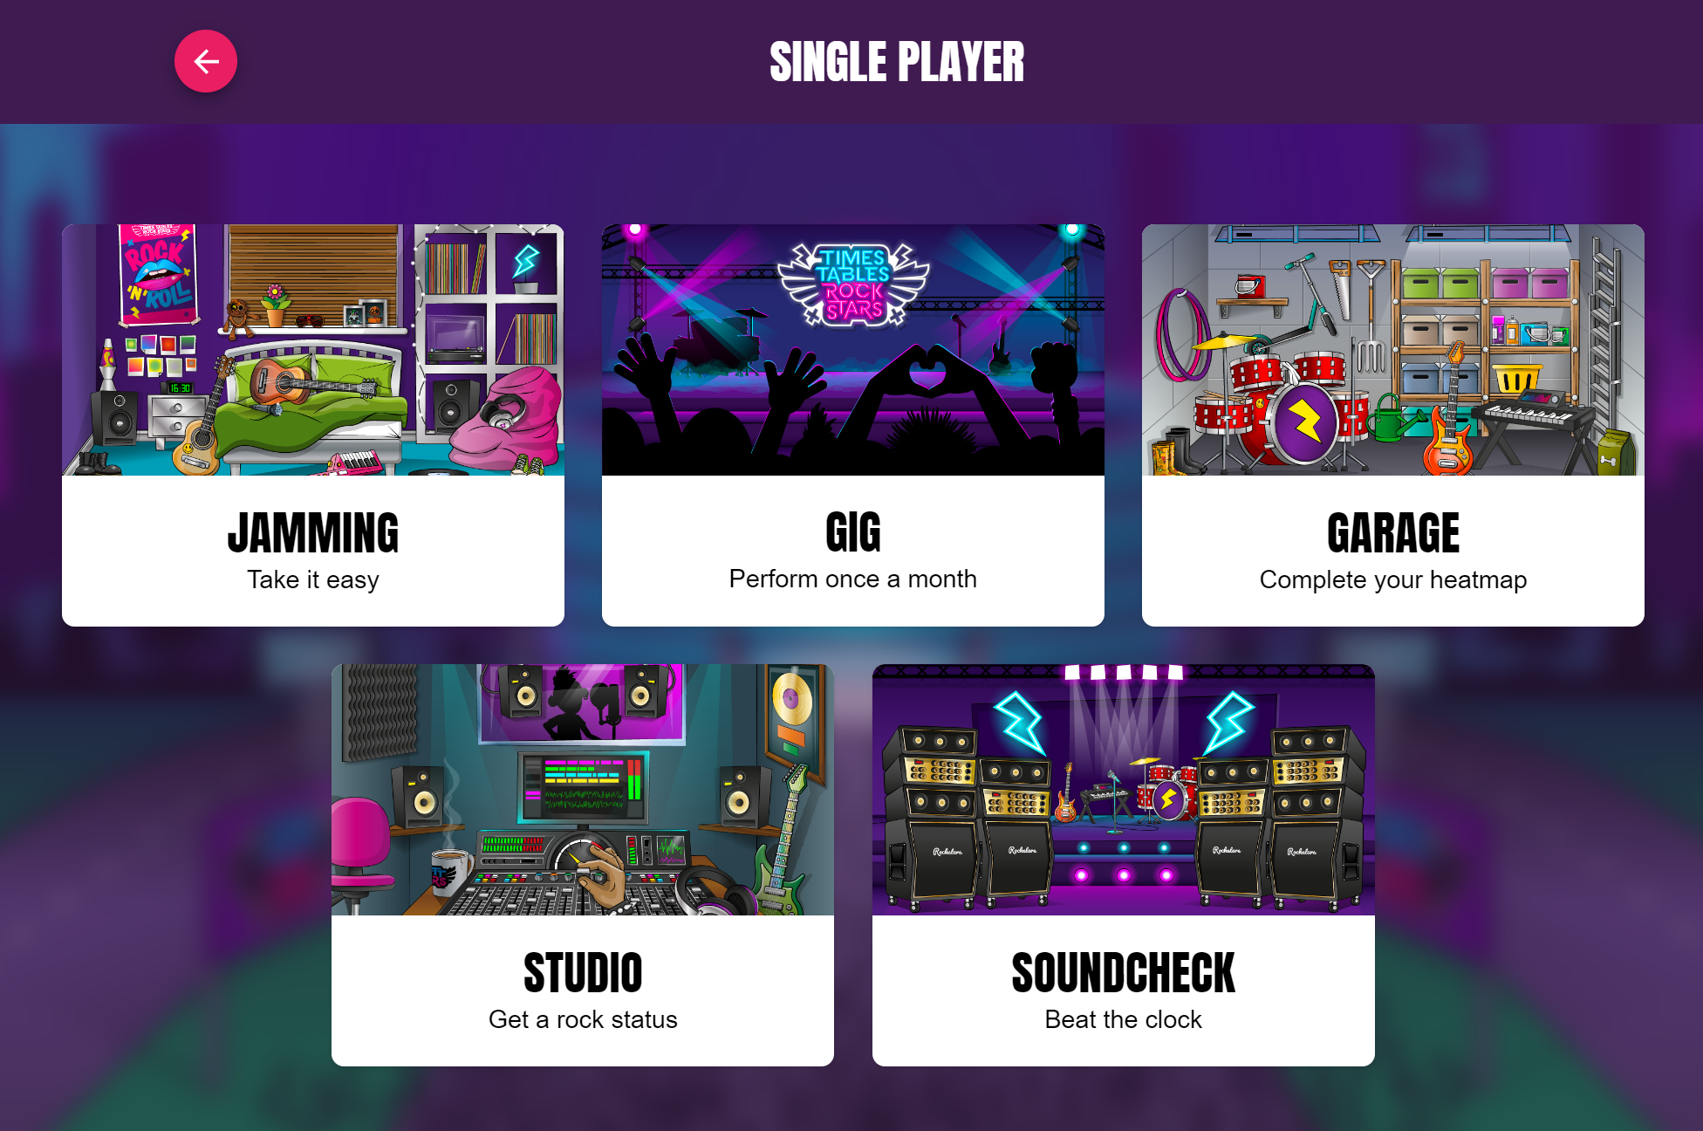
BEST GAME MODES FOR YEAR 4
Notes:
Garage – where the questions are personalised for your child
Soundcheck – copies the MTC format
For info in case anyone asks:
Jamming – good for reinforcing existing tables but not ideal for making progress with unknown ones
Studio – for more of a challenge.
Gig – once a month, gives teachers a score out of 100

Slide 10


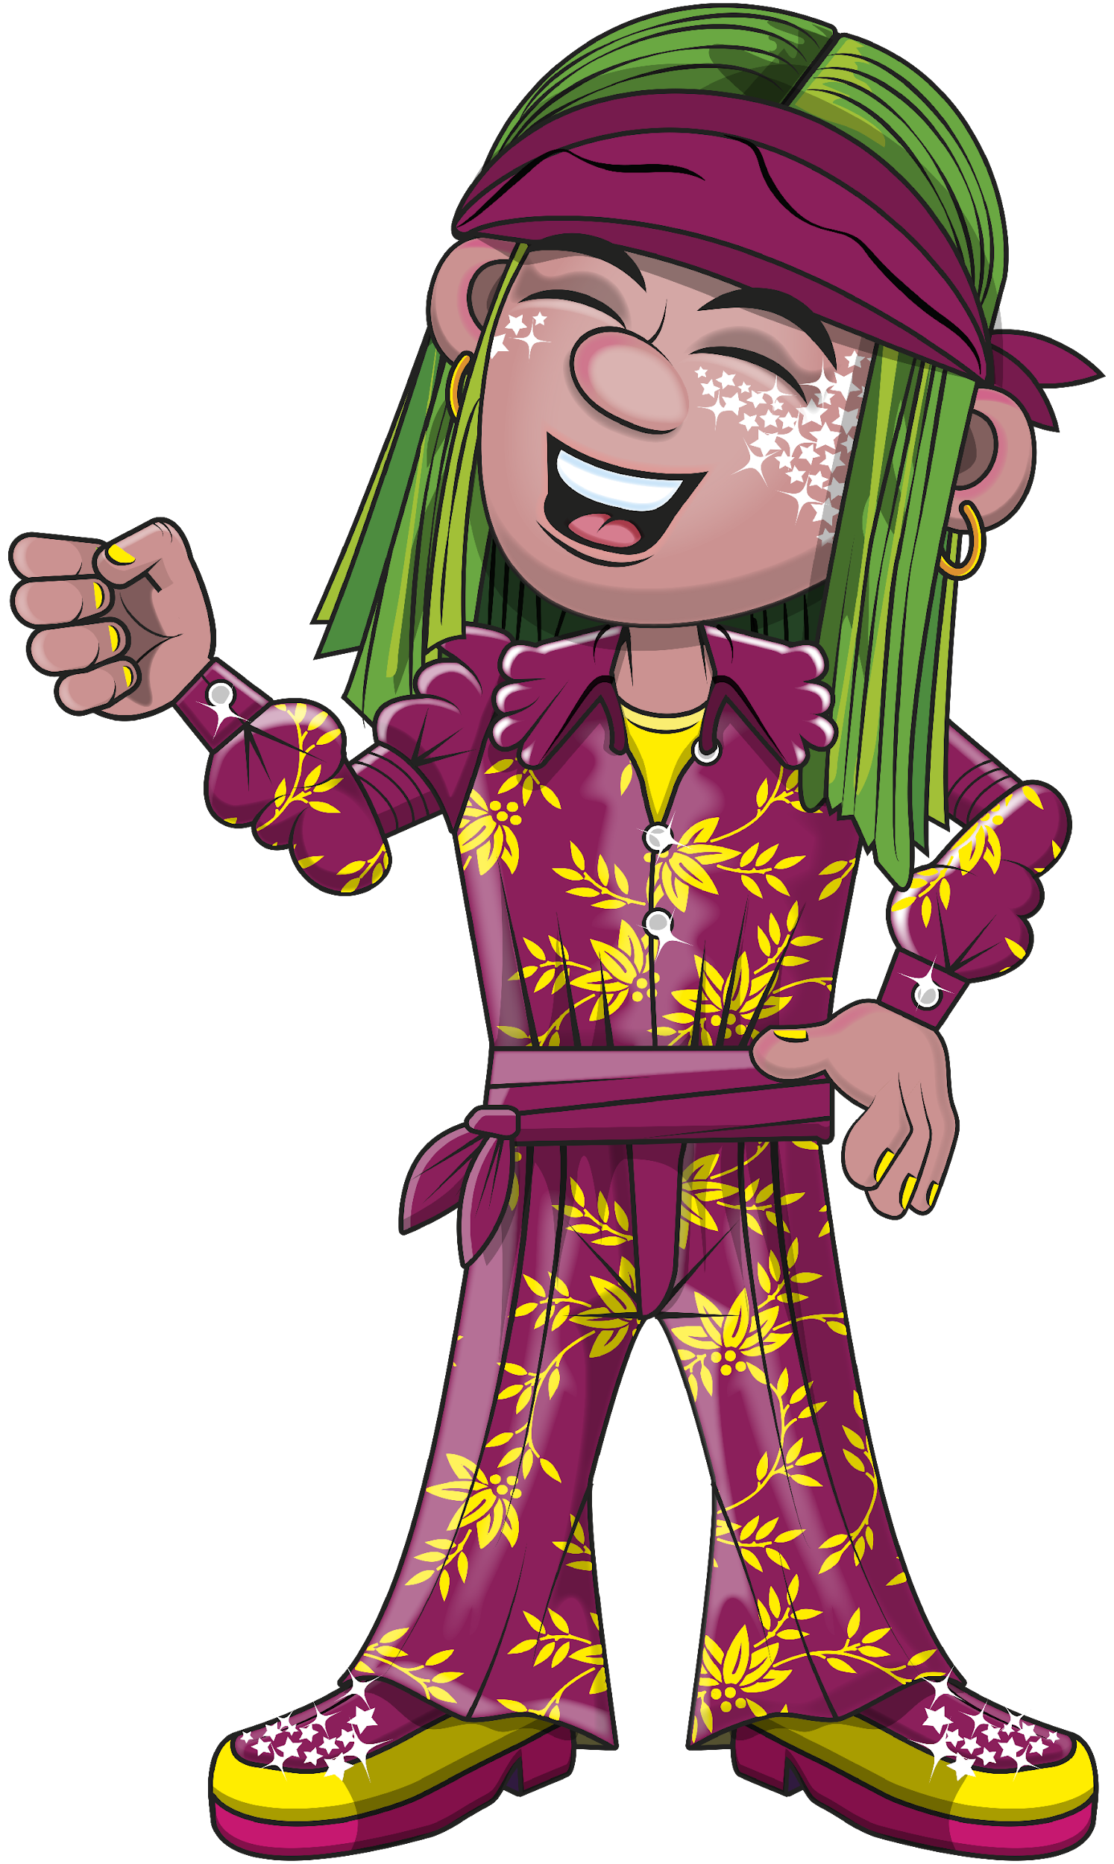
Q & A

